Slide 1
Stack Data Structure
Dr. Naveen Kumar
Associate Professor
Amity Institute of Information Technology
Amity University Patna

Slide 2
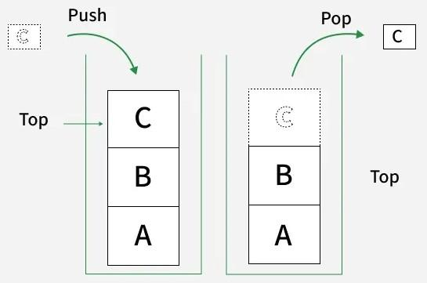

Slide 3
Data Structure
Linear data structure follows LIFO (Last In First Out) Principle,
LIFO(Last In First Out) Principle
New elements are always pushed on top.
Removal (pop) also happens only from the top.
This ensures a strict order: last in → first out.
Real-world examples of LIFO:
Stack of plates – The last plate placed on top is the first one you pick up.
Stack of books – The last book kept is the first one taken out, since both operations happen from the same end.
Basic Terminologies of Stack
Top: The position of the most recently inserted element. Insertions (push) and deletions (pop) are always performed at the top.
Size: Refers to the current number of elements present in the stack.

Slide 4
Types of Stack
Fixed Size Stack
A fixed size stack has a predefined capacity.
Once it becomes full, no more elements can be added (this causes overflow).
If the stack is empty and we try to remove an element, it causes underflow.
Typically implemented using a static array.
Example: Declaring a stack of size 10 using an array.

Slide 5
Types of Stack
Dynamic Size Stack
A dynamic size stack can grow and shrink automatically as needed.
If the stack is full, its capacity expands to allow more elements.
As elements are removed, memory usage can shrink as well.
Can be implemented using: -> Linked List → grows/shrinks naturally. -> Dynamic Array (like vector in C++ or ArrayList in Java) → resizes automatically.
Example: Stack implementation using linked list or resizable array.
Note: We generally use dynamic stacks in practice, as they can grow or shrink as needed without overflow issues.

Slide 6
Common Operations on Stack
In order to make manipulations in a stack, there are certain operations provided to us.
push() operation: to insert an element into the stack.
pop() operation: to remove an element from the stack.
top() operation: Returns the top element of the stack.
isEmpty() check: returns true if stack is empty else false.
size() check: returns the size of the stack.

Slide 7
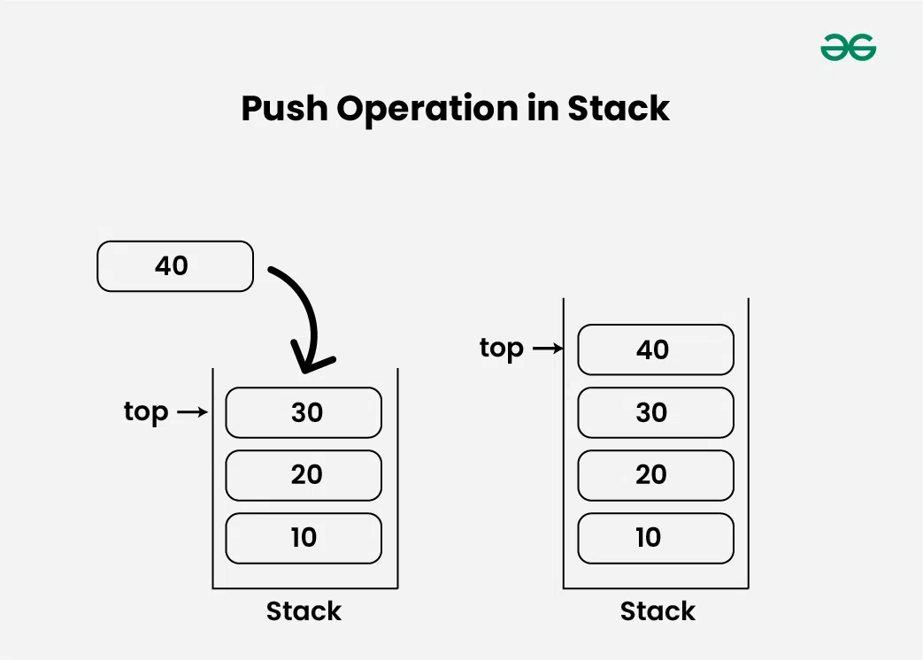

Slide 8
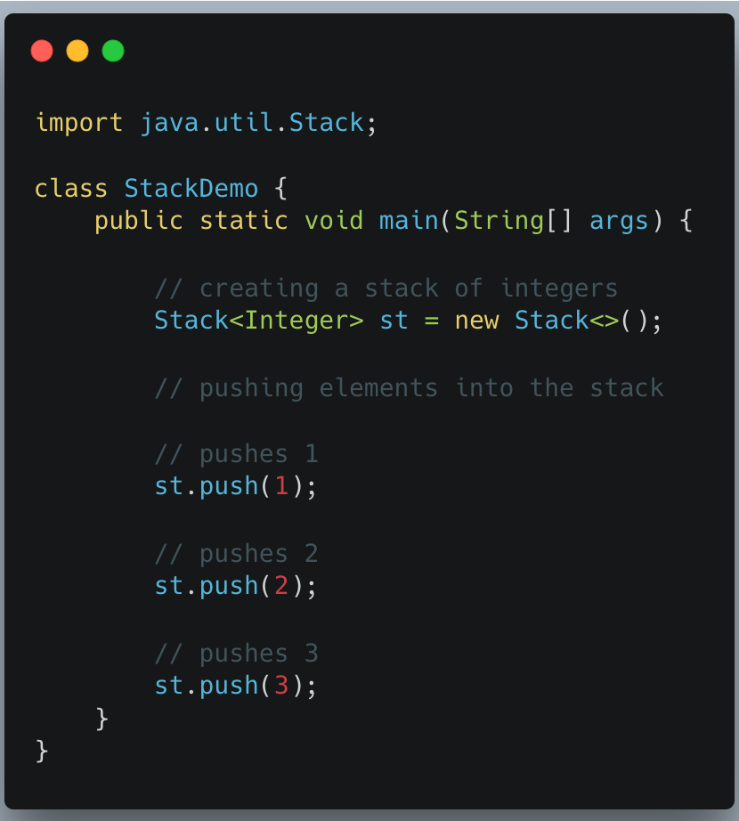
import java.util.Stack;
class GfG {
public static void main(String[] args) {
// creating a stack of integers
Stack<Integer> st = new Stack<>();
// pushing elements into the stack
// pushes 1
st.push(1);
// pushes 2
st.push(2);
// pushes 3
st.push(3);
}
}

Slide 9
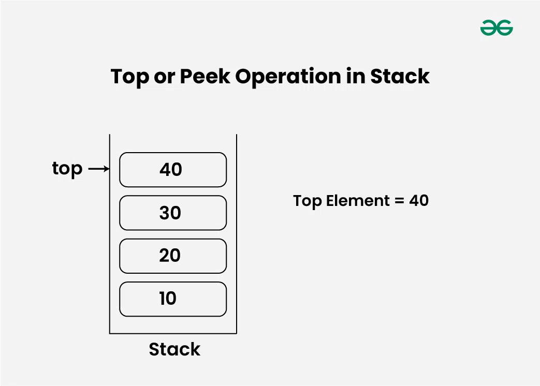

Slide 11
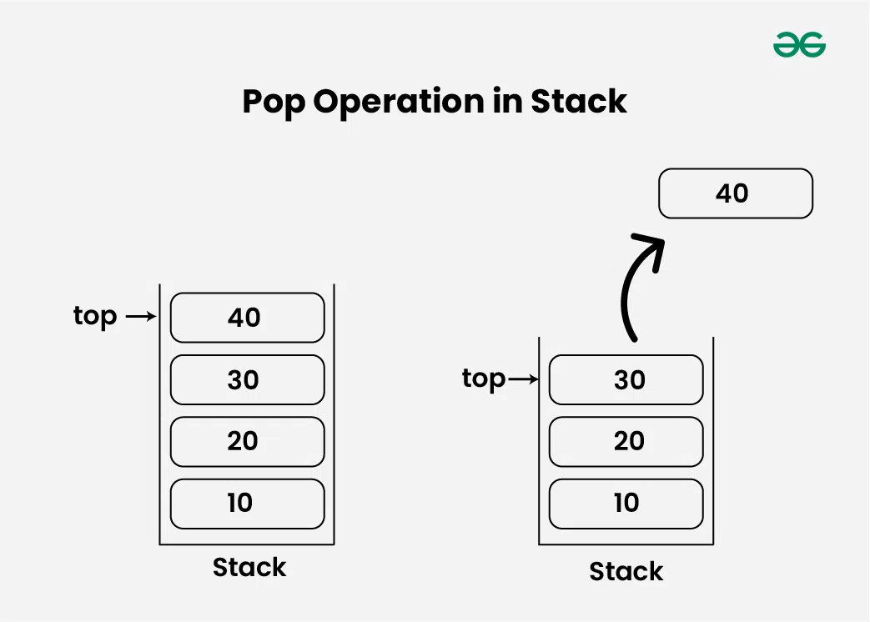

Slide 12
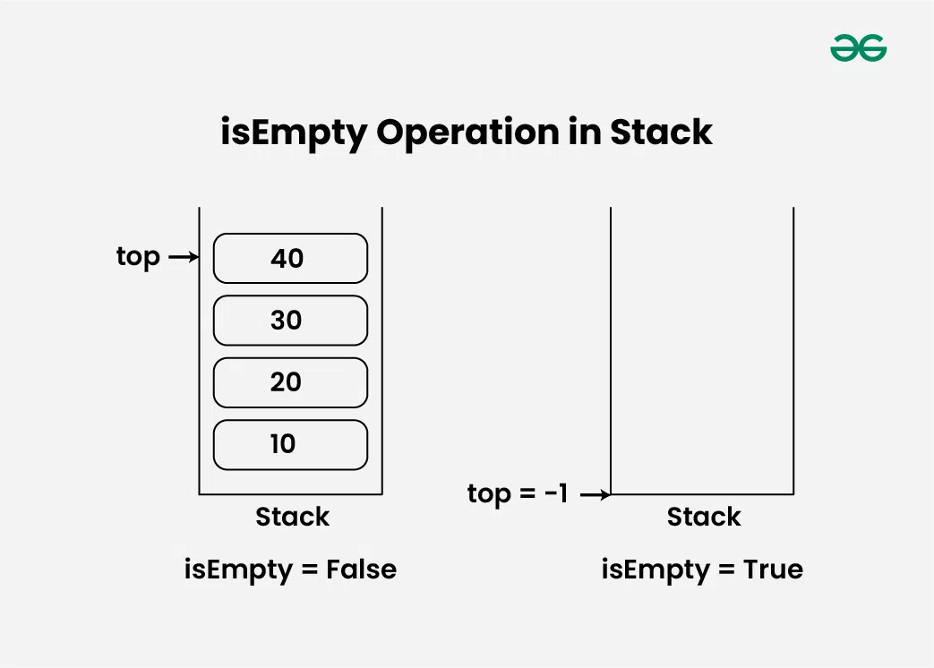

Slide 13
A stack can be implemented using an array where we maintain:
An integer array to store elements.
A variable capacity to represent the maximum size of the stack.
A variable top to track the index of the top element. Initially, top = -1 to indicate an empty stack.

